Slide 2
Objective
In sequence modeling techniques, the Gated Recurrent Unit is the newest entrant after RNN and LSTM, hence it offers an improvement over the other two.
Understand the working of GRU and how it is different from LSTM
Introduction
GRU or Gated recurrent unit is an advancement of the standard RNN i.e recurrent neural network. It was introduced by Kyunghyun Cho et al in the year 2014.

Slide 3
Gated Recurrent Unit (GRU)
The Gated Recurrent Unit (GRU) is a type of Recurrent Neural Network (RNN) that, in certain cases, has advantages over long short term memory (LSTM).
GRU uses less memory and is faster than LSTM, however, LSTM is more accurate when using datasets with longer sequences.
Also, GRUs address the vanishing gradient problem (values used to update network weights) from which vanilla recurrent neural networks suffer. If the grading shrinks over time as it back propagates, it may become too small to affect learning, thus making the neural net untrainable.

Slide 4
If layer in a neural net can’t learn, RNN’s can essentially “forget” longer sequences.
GRUs solve this problem through the use of two gates, the update gate and reset gate.
These gates decide what information is allowed through to the output and can be trained to retain information from farther back.
This allows it to pass relevant information down a chain of events to make better predictions.

Slide 5
GRUs are very similar to Long Short Term Memory(LSTM). Just like LSTM, GRU uses gates to control the flow of information. They are relatively new as compared to LSTM. This is the reason they offer some improvement over LSTM and have simpler architecture.
GRU is that, unlike LSTM, it does not have a separate cell state (Ct). It only has a hidden state(Ht). Due to the simpler architecture, GRUs are faster to train.

Slide 6
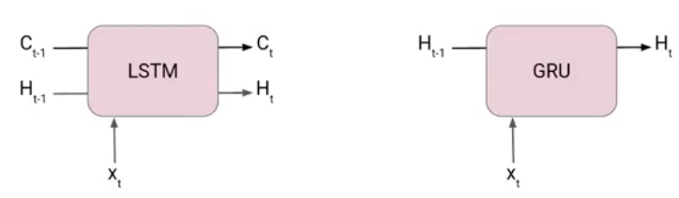

Slide 7
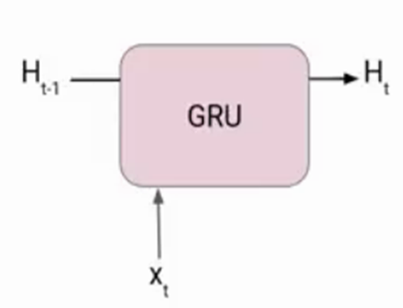
The architecture of Gated Recurrent Unit
Now lets’ understand how GRU works. Here we have a GRU cell which more or less similar to an LSTM cell or RNN cell.
At each timestamp t, it takes an input Xt and the hidden state Ht-1 from the previous timestamp t-1. Later it outputs a new hidden state Ht which again passed to the next timestamp.
Now there are primarily two gates in a GRU as opposed to three gates in an LSTM cell. The first gate is the Reset gate and the other one is the update gate.

Slide 8

Reset Gate (Short term memory)
The Reset Gate is responsible for the short-term memory of the network i.e the hidden state (Ht). Here is the equation of the Reset gate.
If you remember from the LSTM gate equation it is very similar to that. The value of rt will range from 0 to 1 because of the sigmoid function. Here Ur and Wr are weight matrices for the reset gate.

Slide 9

Update Gate (Long Term memory)
Similarly, we have an Update gate for long-term memory and the equation of the gate is shown below.
The only difference is of weight metrics i.e Uu and Wu.

Slide 10


How GRU Works
Now let’s see the functioning of these gates. To find the Hidden state Ht in GRU, it follows a two-step process. The first step is to generate what is known as the candidate hidden state. As shown below
Candidate Hidden State
It takes in the input and the hidden state from the previous timestamp t-1 which is multiplied by the reset gate output rt. Later passed this entire information to the tanh function, the resultant value is the candidate’s hidden state.

Slide 11
The most important part of this equation is how we are using the value of the reset gate to control how much influence the previous hidden state can have on the candidate state.
If the value of rt is equal to 1 then it means the entire information from the previous hidden state Ht-1 is being considered. Likewise, if the value of rt is 0 then that means the information from the previous hidden state is completely ignored.

Slide 12

Hidden state
Once we have the candidate state, it is used to generate the current hidden state Ht. It is where the Update gate comes into the picture. Now, this is a very interesting equation, instead of using a separate gate like in LSTM in GRU we use a single update gate to control both the historical information which is Ht-1 as well as the new information which comes from the candidate state.

Slide 13

Now assume the value of ut is around 0 then the first term in the equation will vanish which means the new hidden state will not have much information from the previous hidden state. On the other hand, the second part becomes almost one that essentially means the hidden state at the current timestamp will consist of the information from the candidate state only.

Slide 14

Similarly, if the value of ut is on the second term will become entirely 0 and the current hidden state will entirely depend on the first term i.e the information from the hidden state at the previous timestamp t-1.

Slide 15
What is the difference between GRU & LSTM?The few differencing points are as follows: The GRU has two gates, LSTM has three gates GRU does not possess any internal memory, they don’t have an output gate that is present in LSTM In LSTM the input gate and target gate are coupled by an update gate and in GRU reset gate is applied directly to the previous hidden state. In LSTM the responsibility of reset gate is taken by the two gates i.e., input and target.
Conclusion
Through this article, we have understood the basic difference between the RNN, LSTM and GRU units. From working of both layers i.e., LSTM and GRU, GRU uses less training parameter and therefore uses less memory and executes faster than LSTM whereas LSTM is more accurate on a larger dataset. One can choose LSTM if you are dealing with large sequences and accuracy is concerned, GRU is used when you have less memory consumption and want faster results.

